Slide 1
Consider a Library Management System. Develop a JavaScript program that will validate the controls in the forms you have created for the application. State the assumptions you make (business logic you are taking into consideration).
Aim:
To develop a web-based Library Management System that validates user inputs using JavaScript and connects to a database using Servlets and JSP, while also demonstrating a simple Weather Information Webpage UI.
Procedure:
Create an HTML webpage for Library Management System.
Design a form to add books/users.
Apply JavaScript validation for all fields.
Create a JSP page to display data.
Develop a Servlet to handle form submission.
Connect the application to a MySQL database.
Insert validated data into the database.
Run the project on a server (e.g., Apache Tomcat).
Display success or error messages.
Code:
1.Html
<!DOCTYPE html>
<html>
<head>
<title>Library Management System</title>
<script>
function validateForm() {
let name = document.forms["libForm"]["name"].value;

Slide 2
let email = document.forms["libForm"]["email"].value;
let phone = document.forms["libForm"]["phone"].value; let book = document.forms["libForm"]["book"].value;
let namePattern = /^[A-Za-z ]+$/;
let emailPattern = /^[^ ]+@[^ ]+\.[a-z]{2,3}$/;
if (name == "" || email == "" || phone == "" || book == "") { alert("All fields must be filled out");
return false;
}
if (!name.match(namePattern)) {
alert("Name must contain only alphabets"); return false;
}
if (!email.match(emailPattern)) { alert("Invalid email format"); return false;
}
if (phone.length != 10 || isNaN(phone)) { alert("Phone must be 10 digits"); return false;
}
return true;
}

Slide 3
</script>
</head>
<body>
<h2>Library Management System</h2>
<form name="libForm" action="LibraryServlet" method="post" onsubmit="return validateForm()">
Name: <input type="text" name="name"><br><br> Email: <input type="text" name="email"><br><br> Phone: <input type="text" name="phone"><br><br> Book Name: <input type="text" name="book"><br><br>
<input type="submit" value="Submit">
</form>
</body>
</html>
2.Servlet (Java):
import java.io.*; import javax.servlet.*;
import javax.servlet.http.*; import java.sql.*;
public class LibraryServlet extends HttpServlet {
public void doPost(HttpServletRequest request, HttpServletResponse response) throws ServletException, IOException {
String name = request.getParameter("name"); String email = request.getParameter("email"); String phone = request.getParameter("phone"); String book = request.getParameter("book");

Slide 4
try {
Class.forName("com.mysql.jdbc.Driver"); Connection con = DriverManager.getConnection(
"jdbc:mysql://localhost:3306/library", "root", "password");
PreparedStatement ps = con.prepareStatement(
"INSERT INTO users(name,email,phone,book) VALUES(?,?,?,?)");
ps.setString(1, name); ps.setString(2, email); ps.setString(3, phone); ps.setString(4, book);
int i = ps.executeUpdate();
response.setContentType("text/html"); PrintWriter out = response.getWriter();
if (i > 0) {
out.println("<h3>Record Inserted Successfully!</h3>");
} else {
out.println("<h3>Error inserting record</h3>");
}
} catch (Exception e) { e.printStackTrace();
}
}
}

Slide 5
3. JSP Page (Display):
<%@ page import="java.sql.*" %>
<html>
<body>
<h2>Library Records</h2>
<table border="1">
<tr>
<th>Name</th>
<th>Email</th>
<th>Phone</th>
<th>Book</th>
</tr>
<%
try {
Class.forName("com.mysql.jdbc.Driver"); Connection con = DriverManager.getConnection(
"jdbc:mysql://localhost:3306/library", "root", "password"); Statement stmt = con.createStatement();
ResultSet rs = stmt.executeQuery("SELECT * FROM users"); while(rs.next()) {
%>
<tr>
<td><%= rs.getString("name") %></td>
<td><%= rs.getString("email") %></td>
<td><%= rs.getString("phone") %></td>
<td><%= rs.getString("book") %></td>
</tr>
<%
}

Slide 6
} catch(Exception e) {
out.println(e);
}
%>
</table>
</body>
</html>
4. Simple Weather Webpage (UI only):
<!DOCTYPE html>
<html>
<head>
<title>Weather Info</title>
</head>
<body>
<h1>Weather Information</h1>
<p>City: Chennai</p>
<p>Temperature: 32°C</p>
<p>Condition: Sunny</p>
</body>
</html>

Slide 7

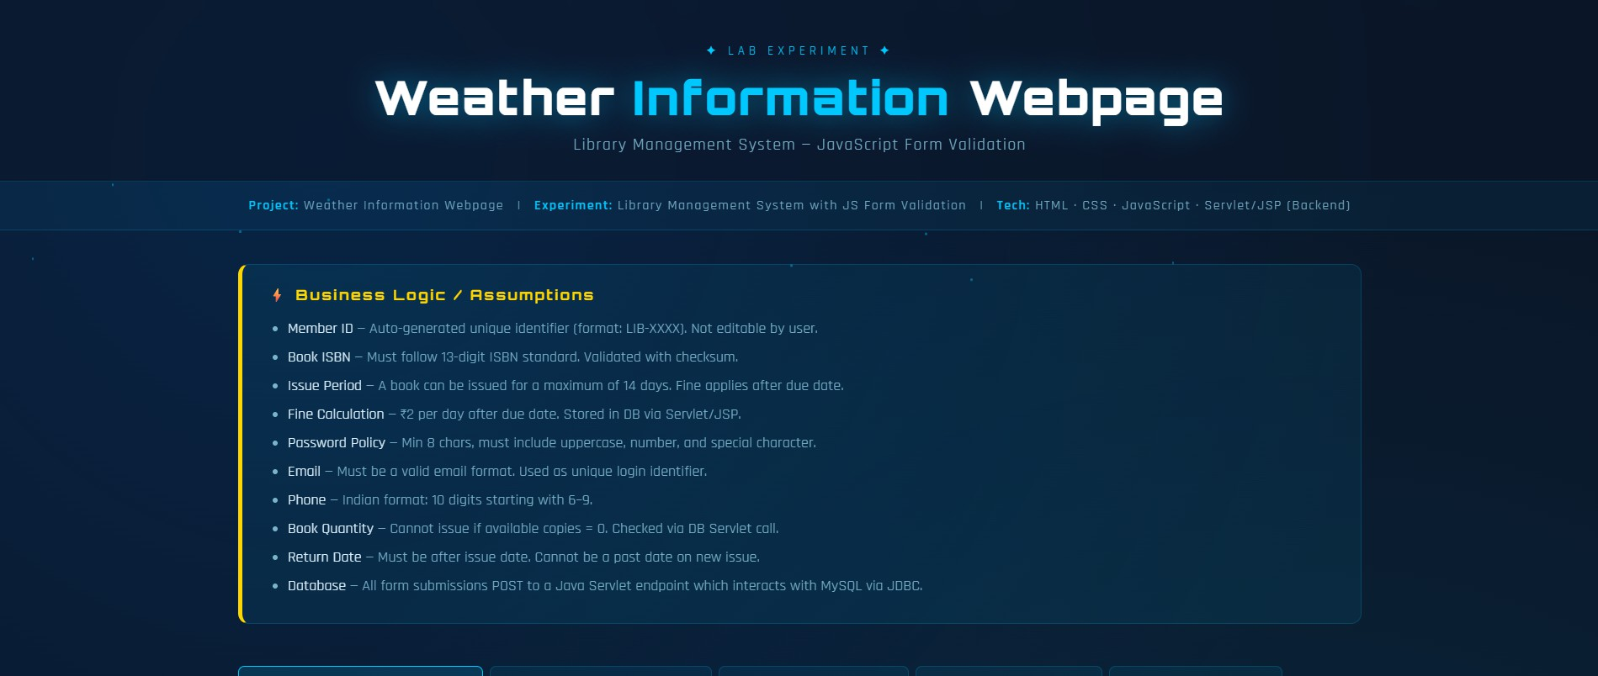
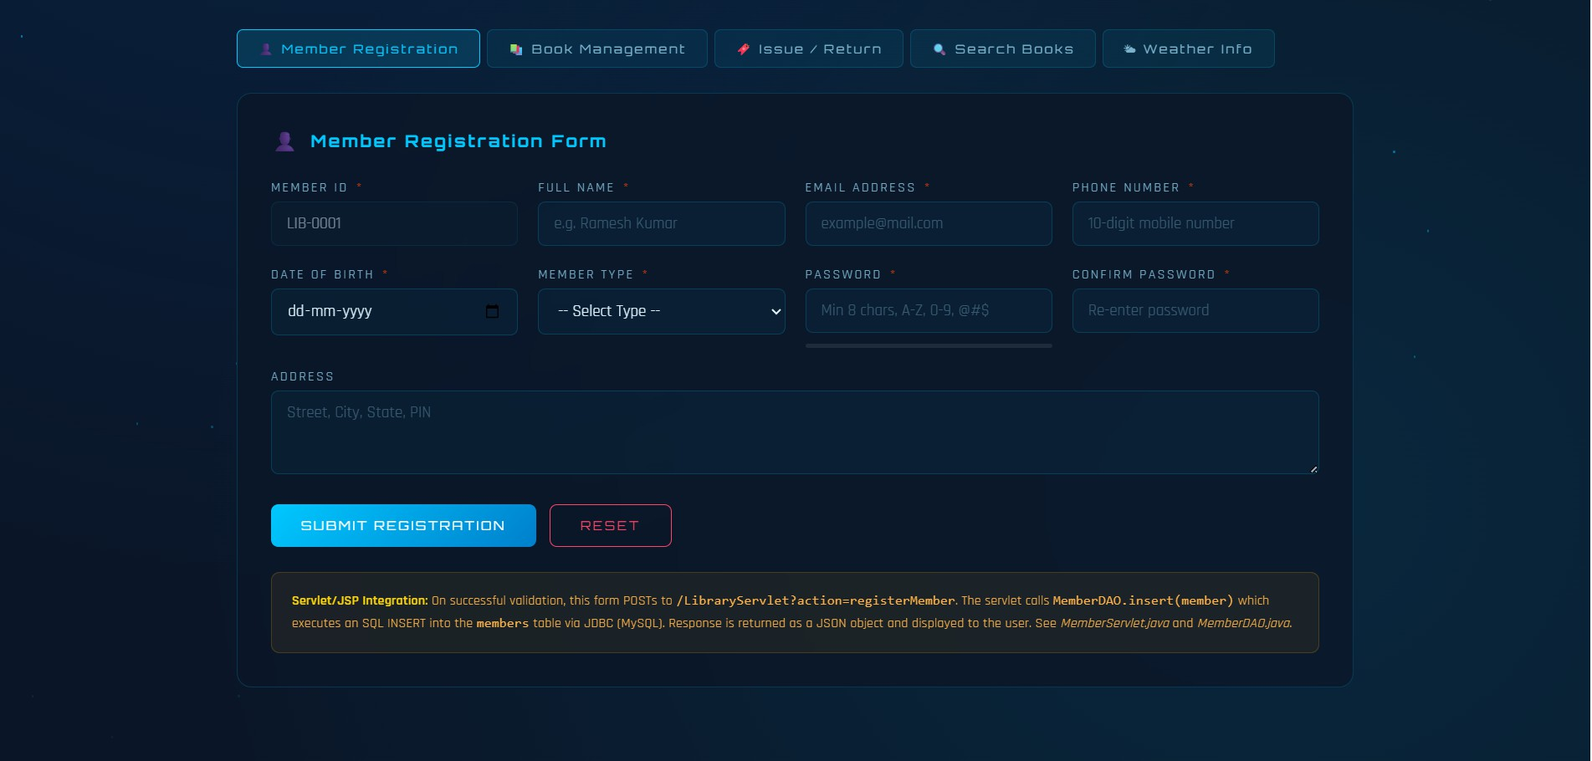
Output:

Slide 8
Result:
Thus, the Library Management System with JavaScript validation and database connectivity using Servlet and JSP was successfully developed and executed.

